Slide 1
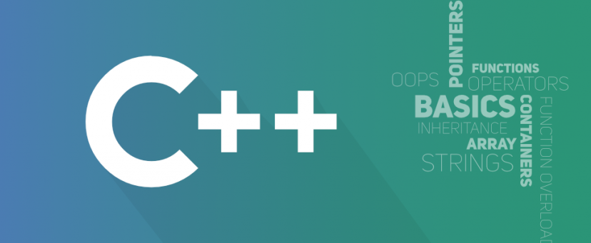
Object Oriented Programming
António J. R. Neves
DETI/UA
Sessão 4

Slide 2
Contents
Introduction to Standard Template Library
Containers
Iterators
Vectors
Sets
Maps
Standard Template Algorithms

Slide 3
Introduction to the Standard Template Library (1)
Most computer programs exist to process data
The data may represent a wide variety of real-world information
Whatever it represents, data is stored in memory and manipulated in similar ways
University computer science programs typically include a course called “Data Structures and Algorithms”
The term data structures refers to the ways data is stored in memory, and algorithms refers to how it is manipulated
Standard C++ includes its own built- in container class library called the Standard Template Library (STL)
STL can be used as a standard approach to storing and processing data
https://www.studytonight.com/cpp/stl/stl-introduction

Slide 4
Introduction to the Standard Template Library (2)
The three most important entity in STL are containers, algorithms, and iterators
A container is a way that stored data is organized in memory - the STL containers are implemented by template classes, so they can be easily customized to hold different kinds of data
Algorithms in the STL are procedures that are applied to containers to process their data in various ways (example: sort, copy, search, and merge data) - algorithms are represented by template functions
Iterators are a generalization of the concept of pointers: they point to elements in a container - are a key part of the STL because they connect algorithms with containers

Slide 5
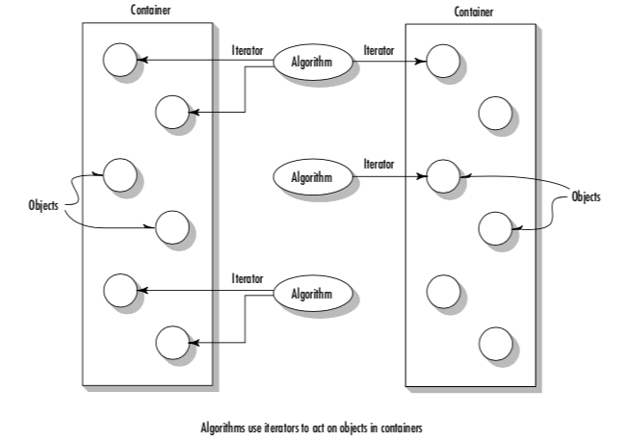
Introduction to the Standard Template Library (3)

Slide 6
Containers
A container is a way to store data, whether the data consists of built-in types such as int and float, or of class objects
The STL makes seven basic kinds of containers available, as well as three more that are derived from the basic kinds
We can create our own container based on the basic kinds
Two main categories:
sequence - vector, list, and deque (and stack, queue, and priority queue)
associative - set, multiset, map, and multimap
Why not use C++ arrays in all data storage situations? The answer is efficiency…

Slide 7
Sequence Containers
A sequence container stores a set of elements in what you can visualize as a line
Each element (except at the ends) is preceded by one specific element and followed by another
An ordinary C++ array is an example of a sequence container
One problem with a C++ array is that you must specify its size at compile time - the vector container avoid this issue
To insert a value in an array, keeping some kind of sorting, we have to move all the elements one position after the insertion position - the list container avoid this issue
deque can be seen as a combination of a stack (last-in-first-out) and a queue (first-in-first-out)

Slide 8
Associative Containers
An associative container is not sequential; instead it uses keys to access data
The keys, typically numbers or strings, are used automatically by the container to arrange the stored elements in a specific order
sets and maps store data in a structure called a tree, which offers fast searching, insertion, and deletion
A set stores a number of items which contain keys - the keys are the attributes used to order the items
A map stores pairs of objects: a key object and a value object
A map is often used as a container that’s somewhat like an array, except that instead of accessing its elements with index, you access them with indices that can be of an arbitrary type

Slide 9
Examples
std::array<int, 3> a2 = {1, 2, 3}; // an array of 3 ints
std::vector<int> aVect; //create a vector of ints
std::list<string> aList; //create a list of strings
std::set<int> intSet; //create a set of ints
std::map<string, int> // map: string as key and int as value
Some common functions to all containers:
size() - Returns the number of items in the container
empty() - Returns true if container is empty
begin() - Returns an iterator to the start of the container
end() - Returns an iterator to the past-the-end location in the container, used to end forward iteration

Slide 10
arrays
std::array is a container that encapsulates fixed size arrays
This container is an aggregate type with the same semantics as a struct holding a C-style array
array combines the performance and accessibility of a C-style array with the benefits of a standard container, such as knowing its own size, supporting assignment, random access iterators, etc.
Member functions:
at(), operator []
front(), back(), data()
size(), empty()
begin(), end()

Slide 11
Examples
std::array<int, 3> a1 = {1, 2, 3};
for(auto n : a1)
std::cout << n << ' '; // 1 2 3
std::cout << std::endl;
std::array<std::string,2> a2 = { std::string("aaa"), "bbb" };
for(auto s : a2)
std::cout << s << ' '; // aaa bb
std::cout << '\n';
// deduction guide for array creation (since C++17)
std::array a3{3.0, 1.0, 4.0}; //std::array<double, 3>
std::cout << a3.size() << std::endl; // 3

Slide 12
Vectors
We can think of vectors as smart arrays - they manage storage allocation, expanding and contracting the size of the vector as you insert or erase data
We can use vectors as an array, accessing elements with the [] operator
It’s also fast to add (or push) a new data item onto the end (the back) of the vector
Member functions:
push_back(), size(), operator []
back(), and pop_back()
swap(), empty()
insert() and erase()

Slide 13
Examples
vector<int> v;
v.push_back(10);
v.push_back(11);
v.push_back(12);
v.push_back(13);
for(int j=0; j<v.size(); j++)
cout << v[j] << ‘ ‘; //10 11 12 13
cout << endl;
vector<int> v2(5);
v.swap(v2);
while( !v2.empty() ){
cout << v2.back() << ‘ ‘; //13 12 11 10
v2.pop_back();
}

Slide 14
Iterators
Iterators are pointer-like entities that are used to access individual data items in a container
Often they are used to move sequentially from element to element, a process called iterating through the container
can increment iterators with the ++ operator so they point to the next element, and dereference them with the * operator to obtain the value of the element they point to
There are three major classes of iterators: forward, bidirectional, and random access
A forward iterator can only move forward through the container, one item at a time. Its ++ operator accomplishes this
A bidirectional iterator can move backward as well as forward, so both its ++ and -- operators are defined
A random access iterator can jump to an arbitrary location

Slide 15
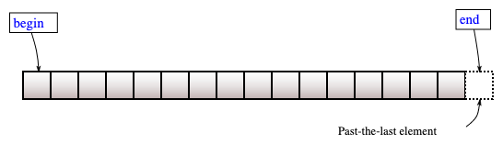
Iterators
#include <iostream>
#include <vector>
#include <iterator>
int main() {
std::vector<int> v = { 3, 1, 4 };
auto vi = std::begin(v);
std::cout << *vi << '\n'; //3
int a[] = { -5, 10, 15 };
auto ai = std::begin(a);
std::cout << *ai << '\n'; //-5
}
#include <iostream>
#include <vector>
#include <iterator>
int main() {
std::vector<int> v = { 3, 1, 4 };
std::vector<int>::iterator it;
it = v.begin();
while(it != v.end()){
std::cout << *it << "-";
it++;
} //3-1-4
}

Slide 16
Sets
Sets are containers that store unique elements following a specific order
In a set, the value of an element also identifies it and and each value must be unique
set<string> s;
s.insert("Ana");
s.insert("Joana");
s.insert("Elena");
s.insert("Maria");
set<string>::iterator i;
for(i = s.begin() ; i != s.end(); i++)
cout << *i << endl;
s.erase("Ana");
for(auto x : s)
cout << x << endl;

Slide 17
Map
A map stores pairs - a pair consists of a key object and a value object
The key object contains a key that will be searched for. The value object contains additional data
For example, the key could be a word, and the value could be a number representing how many times that word appears in a document - such a map constitutes a frequency table
map<string, int> m;
m["ola"] = 10;
m["poo"] = 20;
m["Avr"] = 15;
// after C++11
for(auto i : m){
cout << i.first << i.second;
cout << endl;
}
// after C++17
for(auto [key, val] : m)
cout << key << val << endl;

Slide 18
STL Algorithms
The algorithms library defines functions for a variety of purposes that operate on ranges of elements
searching
sorting
counting
manipulating
…
A range is any sequence of objects that can be accessed through iterators or pointers, such as an array or an instance of some of the STL containers
Algorithms operate through iterators directly on the values, not affecting in any way the structure of any possible container
https://en.cppreference.com/w/cpp/algorithm

Slide 19
Sorting
Example: sort - sorts the elements in the range [first, last) in ascending order
by default elements are compared using operator <.
Elements can be compared using a given binary comparison function
Sorting a vector of integers:
vector<int> v = {5, 2, 3, 1, 4};
// by default elements are sorted in ascending order
sort(v.begin(), v.end());
for(int i : v)
cout << i << endl;
cout << endl;
// sorting in descending order using the greater func.
sort(v.begin(), v.end(), greater());
for(int i : v)
cout << i << endl;

Slide 20
Comparison Functions in C++
There are many C++ STL functions that require the underlying parameter to have an ordering, such as sort()
Obviously, we can only sort a collection of objects if we can tell whether an object must come before another, so it is important to learn how to define an ordering in a class
There are also many C++ STL containers that require the underlying type to have an ordering, such as set<T> or the key on a map
Defining an ordering of a class T means that for all two objects a and b of type T, we can always determine whether a must precede b in the ordering
The definition is then implemented in a function that returns a boolean denoting the precedence

Slide 21
Define ordering
There are (at least) three ways to define an ordering in C++:
Define operator<() - this method can be used if we want objects of a custom class to be able to be sorted naturally.
Define a custom comparison function - use this method if you are comparing built-in types, you cannot modify the class you are comparing, or you want to define another ordering besides its natural ordering - basically, a comparison function is just a function that takes two parameter of the same type and returns a boolean:
bool name(T a, T b)
Define operator()() - a functor, or a function object, is an object that can behave like a function. This is done by defining operator()() of the class

